Slide 1
CUSTOMER SUPPORT & TICKET RESOLUTION
ANALYSIS
Are we resolving support
tickets fast enough?
A Power BI analysis of 1,000 support tickets
Monisha R · Power BI · DAX · Power Query
Notes:
Open with the question the whole project answers: are tickets being resolved fast enough? The data is synthetic.

Slide 2
The short version
78%
21%
4.06 / 3.06
of resolved tickets met their SLA target
of tickets are still open or in progress (209)
average CSAT for on-time vs late tickets
Most tickets are handled on time, but late ones cost customer satisfaction, and Technical Issues and a few slower agents drive most of the delay.
Notes:
Give the three headline numbers first. Everything after this slide explains where they come from.

Slide 3
How the analysis was built
1
2
3
4
5
Load
Clean
Model
Measure
Visualize
Imported the CSV into Power BI
Fixed date and number types in Power Query
Added a date table and relationship
Wrote DAX for tickets, hours, SLA %, CSAT
Built cards, charts and slicers on page
Dataset: 1,000 tickets · Jan to Dec 2025 · 12 columns · synthetic data
Notes:
Walk through the five steps quickly. Mention that the dataset is synthetic: 1,000 tickets across 2025 with 12 columns.

Slide 4
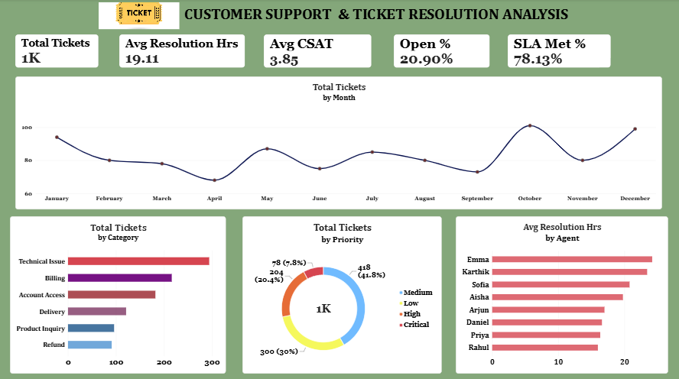
The dashboard
Paste your dashboard screenshot here
Win + Shift + S to capture, then Ctrl + V
5 KPI cards
Monthly trend
Category, priority and agent charts
4 slicers
Notes:
This is the one-page Power BI dashboard. Slicers filter every visual by date, category, priority and agent.

Slide 5
01
WHERE
Technical Issues are the biggest and slowest category
29%
of all tickets (294)
They average 24.8 hrs to resolve. Product Inquiry takes only 11.0 hrs.
Notes:
Technical Issues are both the largest category and the slowest to resolve, so they are the biggest lever for improvement.

Slide 6
02
WHEN
Demand peaks in October and December
101
tickets in October, the peak
Volume sits near 70 to 95 in most months. April is the quietest at 68.
Notes:
Volume is uneven. October (101) and December (99) are peaks, April (68) is the lowest. Staffing should follow the peaks.

Slide 7
03
HOW FAST
Late tickets cost a full point of satisfaction
+1.0
CSAT when SLA is met
78% of resolved tickets are on time. Medium priority is weakest at 70%. 209 tickets are still open.
Notes:
SLA is measured on resolved tickets only. The dashboard card shows 61.8% because it divides by all 1,000 tickets including open ones.

Slide 8
04
WHO
Resolution speed depends on who handles the ticket
8.2 hrs
gap between fastest and slowest
Rahul averages 16.0 hrs and Emma 24.2. Names are illustrative because the data is synthetic.
Notes:
Agent averages range from 16.0 to 24.2 hours. Sharing the fastest agents' habits could lower the team average.

Slide 9
What to do next
Quick wins
Process changes
Longer term
Escalate tickets close to breaching SLA
Add a tier-2 queue for Technical Issues
Forecast monthly ticket volume
Late tickets cut CSAT by a point
29% of tickets, slowest at 24.8 hrs
Plan staffing before peaks
Pair slower agents with the fastest
Roster extra cover in Oct and Dec
Predict SLA breaches with Python
Agent gap is 8.2 hrs
Peaks of 101 and 99 tickets
Act before a ticket goes late
Notes:
Each action is tied to a finding from the four chapters. Quick wins need no new tools.

Slide 10
Takeaways and limits
1
Fix Technical Issues first
Limits
They are the biggest and the slowest category.
Synthetic dataset, so real patterns may differ
One year of data, no ticket text
Findings are associations, not causes
About 12% of resolved tickets have no CSAT score
2
Protect the SLA
On-time tickets earn a full point more CSAT.
3
Plan for peaks, coach for speed
October and December peak; agents differ by 8 hours.
Notes:
Three takeaways to remember. Be upfront about limits; it builds credibility.

Slide 11
Thank you
Monisha · Customer Support & Ticket Resolution Analysis

